Slide 1
AI Course Selection
Project Audit 2

Slide 2
Progress
What has been done
What has been delayed
How this affects our project timeline
How we will adapt to the changes in the timeline
Propose a new project timeline
Background project timeline
Show ideate and define phases here; less focus on later/earlier phases

Slide 3
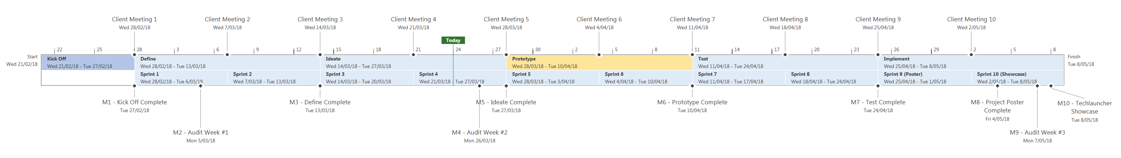
Project Timeline
^
Client Meeting 1
Client Meeting 2
Client Meeting 3
Client Meeting 4
Client Meeting 5
Client Meeting 6
Client Meeting 7
Client Meeting 8
Client Meeting 9
Client Meeting 10
Today
Start Wed 21/02/18
Kick Off
Weeks 1-2
Define Wed 28/02/18 - Tue 13/03/18
Ideate
Weeks 4-6
Prototype
Lecture Break
Test
Weeks 7-8
Implement
Weeks 8-10
Finish Tue 8/05/18
Sprint 1
Weeks 2-3
Sprint 2
Weeks 3-4
Sprint 3
Weeks 4-5
Sprint 4 Weeks 5-6
Sprint 5
Break week 1
Sprint 6
Break week 2
Sprint 7
Week 7
Sprint 8
Weeks 7-8
Sprint 9 (Poster)
Weeks 8-9
Sprint 10 (Showcase)
Weeks 9-10
M8 - Project Poster Complete
M10 - Techlauncher Showcase Tue 8/05/18
M2 - Audit #1
M4 - Audit #2
M9 - Audit #3
Kick Off
Team introductions
TechLauncher induction workshop
Kick off meetings with clients at Accenture
Define
Prepare and send out survey to ANU students
Interview academic officers for relevant information
Collate and analyse the chatbot, interview, and survey data.
Refine the scope of the problem
Ideate
Brainstorm designs and concepts based on gathered data (Sprint 3)
Create a feature list for the product (Sprint 3)
Conceptualise AI framework (Sprint 4)
Prototype options for recommendations of AI model (Sprint 4)
Try out ideas for AI recommendations and searches (Sprint 4)
Prototype
Create high level design for the finalised product (Sprint 5)
Decide on the tech stack
Complete task chunking for first prototype
Meet to assign responsibilities in prototype creation
Code prototype (Sprint 6)
Code reviews
Deploy imitation chatbot for data collection (Sprint 1)

Slide 4
Data Collection Channels
Poll
Survey
Interview
Imitation Chatbot
Distributed Survey
ANU Facebook
Large sample
Definitive answer to “Website or Chatbot?”
ANU Facebook
31 responses
Useful and clear data
Narrowed project scope
APO at Fenner Hall
Refined survey questions
Agreement with poll and survey results
ANU Facebook
Limited results
Questions for Intelligent Search
Large unbiased sample
Survey approved but not deployed
Recommended action: Ethics approval
✔
✔
✔
✔
✘

Slide 5
Chatbot, Website, or App?
Poll
Survey
Platform: Website

Slide 6
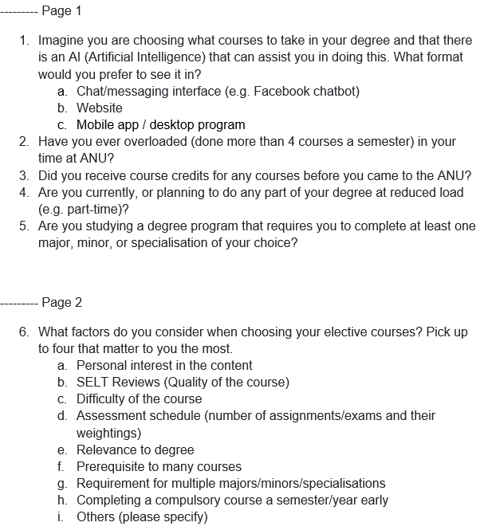
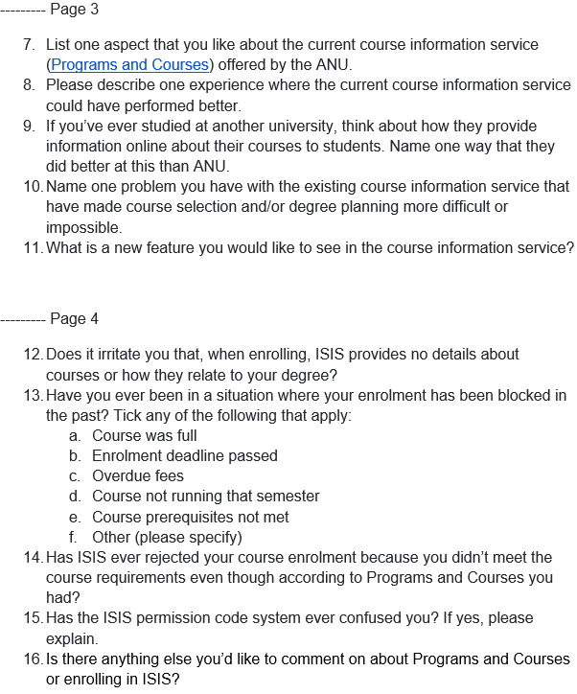
Data collection
Survey generation – show final survey
Results (Just focus on what we’ve gained from the high level perspective)
What we’ve learnt
Positives of current solution | Negatives of current solution | Improvements given
Informative Easy to access and use Convenient layout Studying options | Hard to navigate Incomplete information Outdated courses | Interactive study options Course suggestion Filtering courses Quick preview of courses Consultation services

Slide 7
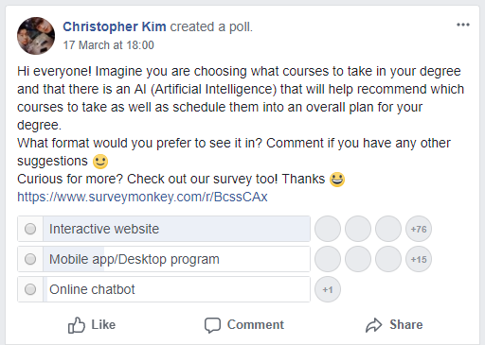
Data collection
Poll generation
Replicated question 1 with different wording
Posting poll to Facebook (with results)
Posted at optimal time for receiving votes
What we’ve learnt
(that website is much more desirable; agrees with survey results)
Strengthens the idea around a website design

Slide 8
Data collection
Face-to-face interview with an Academic Program Officer at Fenner Hall
Results
What we’ve learnt
Good news is that we’re seeing a trend with multiple sets of data/results
Forms a good foundation for the define phase
Main points?: Expert seems most in agreement with survey results, also includes time scheduling could be the main issue for students

Slide 9
Data collection
Proposition to ANUSA
Same survey proposed to ANUSA
Results
Rejected due to importance compared to official surveys

Slide 10
Infographic
Summarise results with visual representation

Slide 11
Define phase (Summary)
Challenges faced
Ontology
Indexing
What has been learnt from what has been done (chatbot)
Could mention feedback from audit 1 here (documentation, organisation etc.)

Slide 12
Planned Features
Intelligent Course Recommendation based on
Personal interests
Relevance to degree
AI Enhanced Search for
Courses by area, title, description, level
Simple program and course questions
Stretch goals
Interactive Degree Planner
Course Recommendation by
SELT Reviews
Opportunity for majors/minors/specialisations

Slide 13
Intelligent Search

Slide 14
Question and Answer
Enhanced Programs and Courses Search
Concept Awareness

Slide 15






AI Architecture
TF–IDF Transform
Programs and Courses Data
Wikipedia-enhanced Course Ontology
Wikipedia Data
Alexa Integration
Lucene Connector
Elastic Search
Intelligent Search

Slide 16
Next Steps
Prototype planned features
Improve with client feedback, implement stretch features
Evaluate user experience and performance
Implement required improvements

